Slide 1

Modelist Market
Insights
Your Monthly Investment Review & Outlook

Slide 2


agenda
  Quick Recap
  Three Themes
  Equity Overview
  Fixed Income Overview
  Global Macro Overview
  Actionable Insights
  Modelist Overview
  Q&A
  Disclosures

Slide 3



Modelist Fills the Industry Blind Spot
Do It Yourself
Value to Clients
Your Brand
Customized
Not Your Expertise
Lacks Compliance
High Cost (Time/Staff)
Outsource
Deep Expertise
Consistent Experience
Compliance
Lacks Transparency
Limited Control
Selling Someone Else
ADVISOR USE ONLY

Slide 4


Our TEAM
Joe Mallen
CEO
Kent Peterson, PhD
CIO
MSc from London Business School
BSB from University of Minnesota
Joe has garnered a significant following among financial advisors, recognized for his insightful market analysis and expertise. He's a source for financial media, quoted by CNBC, Bloomberg, The Wall Street Journal, Barron's, Reuters, MarketWatch, and Yahoo. His thought leadership extends to appearances on prominent industry platforms, including Animal Spirits, The Sherman Show, and TD Ameritrade.
PhD from Princeton University
BA from Cornell University
Kent has spent much of his career between Wall Street and London, excelling in global macro research for some of the world's top investment firms. He started his career at Bridgewater Associates and was recently Head of Global Market Solutions at Santander. His expertise in identifying economic trends has distinguished him as a leading strategist in the finance sector.
ADVISOR USE ONLY

Slide 5
Quick recap
After five continuous months of substantial gains, April saw US equities finally relinquish some ground. All three headline indexes fell after it became clear that the Fed was unlikely to cut rates anytime soon due to persistent inflation numbers. Overseas, the story was mixed. Developed markets also sold off during the month, while emerging markets eked out some gains thanks to improvements in commodity prices and a recovery in mainland Chinese shares. Slow growth and persistently high prices also weighed on bonds this month, pushing yields higher. Yields moved around 80 basis points higher across the curve, which remains in its state of inversion. Economic statistics from April were generally negative, with GDP numbers coming in at 1.6% versus expectations of 2.5%, and inflation figures inching upward, further away from the Fed’s 2% target rate. Despite strong unemployment numbers, consumers also turned gloomier in several surveys. In other markets, the Japanese Yen continued to tumble and is now down more than 10% against the US dollar year-to-date. Oil fell slightly, while gold closed up, after peaking above $2400 mid-month. Finally, the VIX rose as volatility returned to more normal historic levels, with investors seeking to insure some of their recent market gains.
Source: Bloomberg, Modelist
Returns greater than 1-year are annualized.

Slide 6
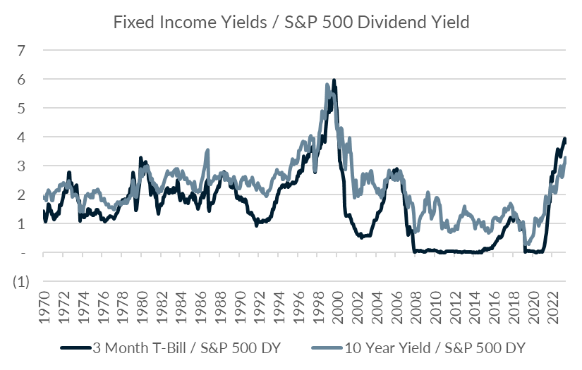
Three Themes
1
Dividend Yields vs. Bonds: A Historic Comparison
One useful way to compare investments and the value they offer is by examining their relative yields. With that in mind, we decided to look at how the dividend yield for the S&P 500 compares to the yield on 3-month T-bills and 10-year notes over the last few decades. Relative to cash rates, the S&P 500's dividend yield has only been less attractive once in the last 60+ years, during the Internet bubble. We see a similar story for 10-year bonds as well. The periods most comparable to today are 1981, 1987, the late 1990s, and 2006-2008, all market tops.
Source: Bloomberg, Modelist

Slide 7
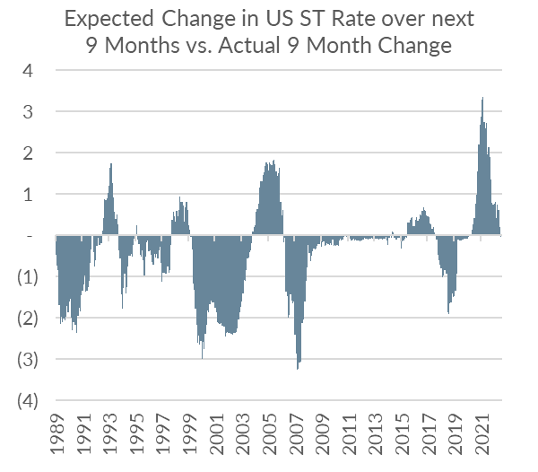
Three Themes
2
Market Expectations vs. Reality: Predicting Short-Term Rates
Twelve-month and two-year US Treasury rates are, in one sense, the market's current expectations or price for what short-term rates, including policy rates, will be in the future. To see how well market prices anticipate actual future changes in short-term rates, we took the difference between the 12-month T-Bill and 3-month T-Bill, which is the market expectation of future rates in 9 months, and then compared that to the actual change in 3-month T-bills over the subsequent 9 months. In the chart, when the line is close to zero, which it was from 2009-2016, it means the market pricing was fairly accurate—rates were expected to stay close to zero and did. By contrast, the market failed to predict the collapse in rates after COVID and then failed to price in the aggressive Fed hikes in 2022. At present, the market expects a decline in rates of 27 basis points over the next 9 months. Given recent economic stats have been running hot, that seems potentially optimistic.
Source: Bloomberg, Modelist

Slide 8
Three Themes
3
Inflation: The Key to Stock-Bond Correlation Dynamics
Inflation, it seems, is a major driver of stock and bond correlations in the US. When you look at levels of Core CPI year-over-year (YoY) over the last 50 years, there is a pretty clear and linear relationship between the current level of annual Core CPI inflation and stock-bond correlations. The lower inflation is, the less correlated bonds are to stocks, and the greater the diversification benefit. This makes some sense, since higher inflation leads to more aggressive Fed tightening, higher bond yields, and slower economic and, therefore, earnings growth. Current Core Inflation numbers are around 3.8% annually, which makes bonds an attractive diversifier.
Source: Bloomberg, Modelist

Slide 9
Equity
Overview

Slide 10
US Equity markets
VIX Index
S&P 500 Index Trailing P/E Ratio & 10-Year Average
S&P 500 Index & 30-Day SMA (2 Standard Deviations)
S&P 500 Index Forward P/E Ratio & 10-Year Average
Source: Bloomberg, Modelist

Slide 11
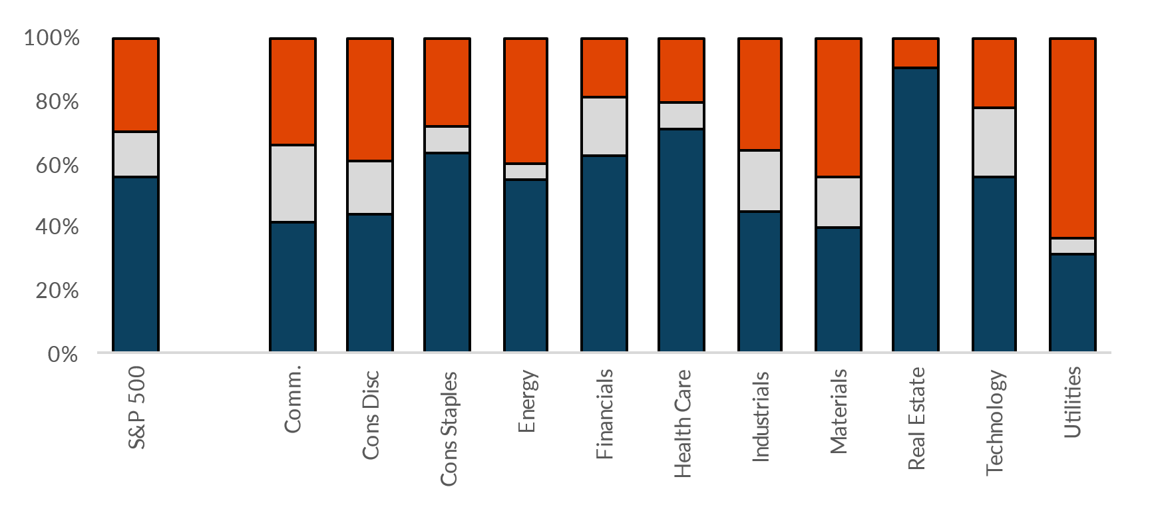
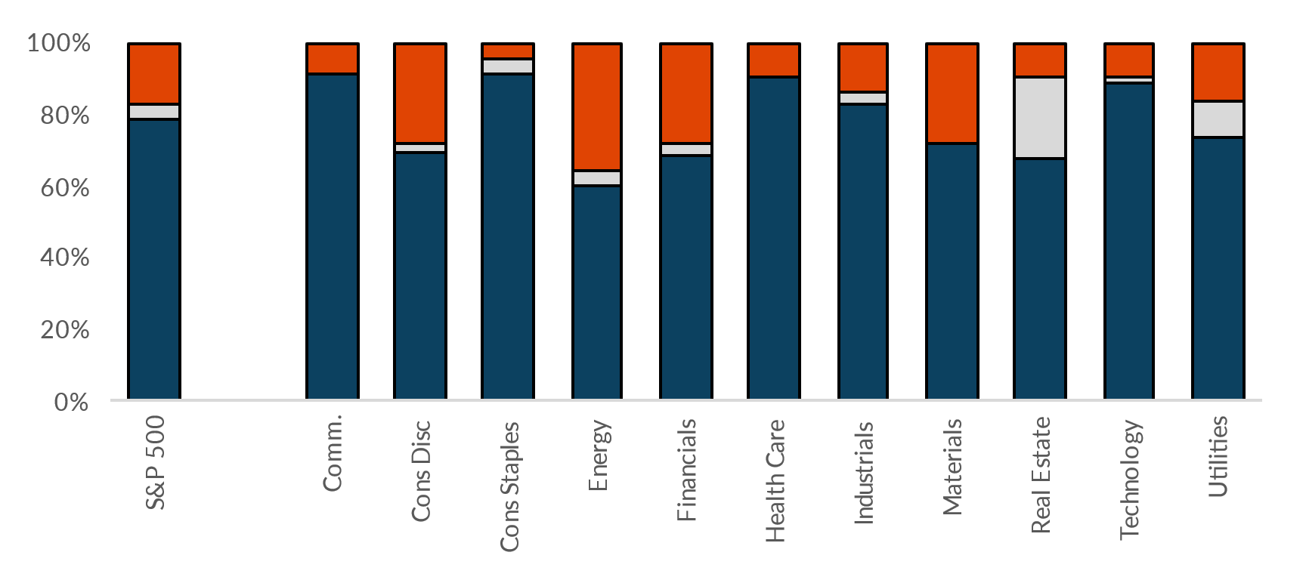
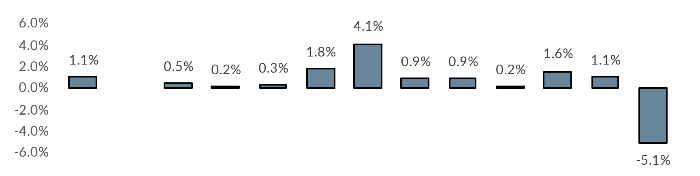
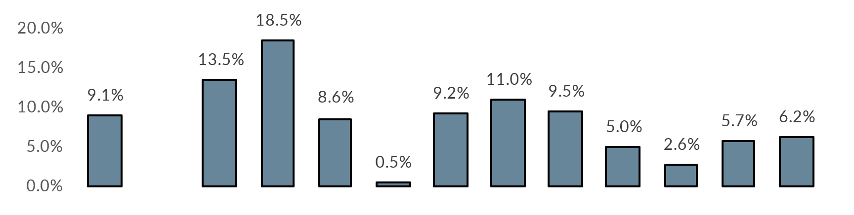
US Equity markets
US Earnings Monitor (Q1 2024, 2/16/24 to 05/15/24)
Sales Surprise (Positive, Inline, Negative)
Earnings Surprise (Positive, Inline, Negative)
Average Sales Surprise
Average Earnings Surprise
Source: Bloomberg, Modelist

Slide 12
US Equity markets
US Style Box Total Return (%)
Source: Bloomberg, Modelist
Returns greater than 1-year are annualized.

Slide 13
US Equity markets
US Sector & Industry Total Return (%)
Source: Bloomberg, Modelist
Returns greater than 1-year are annualized.

Slide 14
international Equity markets
Developed & Emerging Markets Total Return (%)
Source: Bloomberg, Modelist
Returns greater than 1-year are annualized.

Slide 15
Fixed Income
Overview

Slide 16
Fixed Income Markets
US Federal Reserve Policy Monitor
Implied Fed Funds Rate (%)
US CPI YoY NSA & US PCE Core Price YoY SA (%)
US U-3 Unemployment Rate (%) (left) & US Initial Jobless Claims SA (1000s) (right)
Source: Bloomberg, Modelist

Slide 17
Fixed Income Markets
US 10 Year Treasury Yield (%)
Current Treasury Yield Curve & One-Year Ago (%)
US 10 Year minus 2 Year Treasury Yield (%)
High Yield Credit Spread (left) & A-Rated Credit Spread (right) (%)
Source: Bloomberg, Modelist

Slide 18
Fixed Income Markets
Fixed Income Asset Class Total Return (%)
Source: Bloomberg, Modelist
Returns greater than 1-year are annualized.

Slide 19
Global Macro
Overview

Slide 20
US Economic Data
Last Month Positive Surprises
Source: YCharts, Modelist

Slide 21
US Economic Data
Last Month Negative Surprises
Source: YCharts, Modelist

Slide 22
US Economic Data
Next Month’s Calendar
Source: Bloomberg, Modelist

Slide 23
Actionable
insights

Slide 24
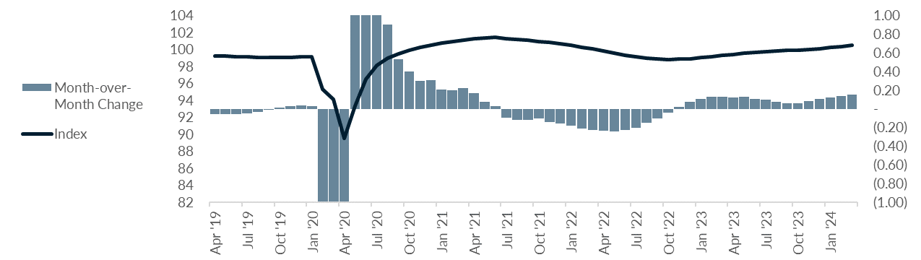
Economic Growth Expectations
OECD G20 Leading Indicators CLI (Composite Leading Indicators) Amplitude Adjusted SA
Economic Growth Expectations
Source: Bloomberg, Modelist

Slide 25
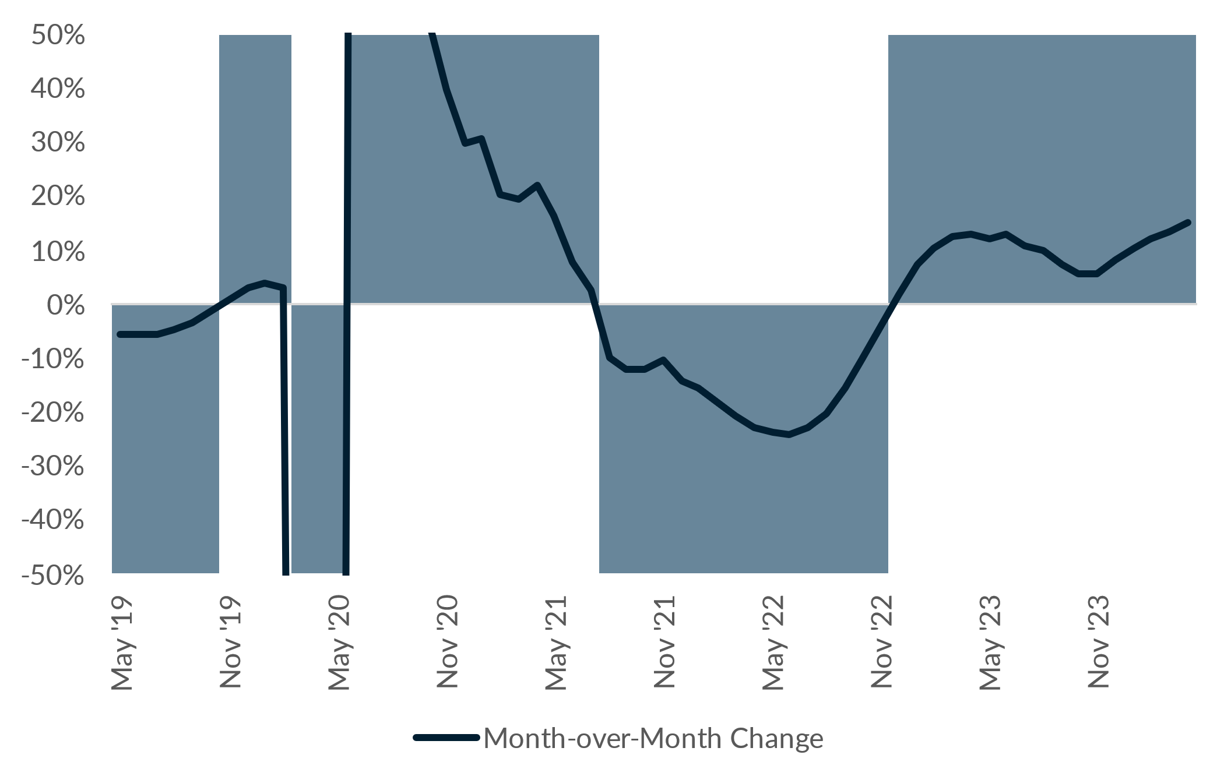
Economic Growth Expectations
Economic Growth Expectations Strategy
Commentary
The Economic Growth Expectations Strategy, as of April 30, 2024, operates based on the latest OECD G20 Composite Leading Indicators, which reported a recent reading of 100.51. This reading suggests continued growth expectations, prompting a portfolio heavily oriented towards riskier assets. The strategy's current allocation includes 25% in US Large Growth, 15% each in International Large Growth, Emerging Markets, High Yield Bonds, Emerging Markets Bonds, and Commodities Broad Basket. These holdings reflect an anticipation of economic expansion, as such assets typically benefit from improved economic conditions, demonstrating the strategy's application of positive change in our growth-oriented investment approach.
Growth
Value
Source: Bloomberg, Modelist

Slide 26

Modelist
Overview
ADVISOR USE ONLY
26

Slide 27

evidence-based approach
Repeatable Process
At Modelist, we build upon a strong foundation of evidence-based investing strategies rooted in robust research and market analysis
Our team conducts thorough research into global macroeconomic trends, technical indicators, and fundamental factors. We distill this data into concise, comprehensible, and actionable insights, enabling financial advisors to seamlessly integrate these valuable perspectives into their models. This approach ensures that advisors can leverage the benefits of our in-depth research in a practical and easily understandable manner.
Informed Decisions
By leveraging these proven strategies, financial advisors gain the insights needed to make well-informed decisions aligned with their clients' goals
Data-Driven Advantage
Trust in your choices and enhance client experiences through research-backed approaches that stand the test of time
ADVISOR USE ONLY

Slide 28
Building Investment Models
Our team recommends specific investment strategies, considering market trends and the advisor's objectives.
Strategic
Tactical
Focuses on long-term investment goals, aligning portfolios with an investor's risk tolerance and time horizon through a stable asset allocation.
  Diversified Equity
  Diversified Fixed Income
  Risk Levels
  Target Date
  Risk Parity
Adopts a more active approach, adjusting the portfolio in response to market opportunities and trends.
  Relative Strength
  Relative Value
  Relative Quality
  Sector Strength
  Factor Strength
  Credit Management
  Duration Management
  Select Macroeconomic
  Leading Economic
  Coincident Economic
  Consumer Sentiment
  Growth Expectations
  Inflation Expectations
Specialized
Enhances portfolios by incorporating diverse assets and approaches, aiming for tailored objectives beyond traditional risk assessment.
  Alternative Assets
  Geographic Bias
  Enhanced Yield
ADVISOR USE ONLY

Slide 29
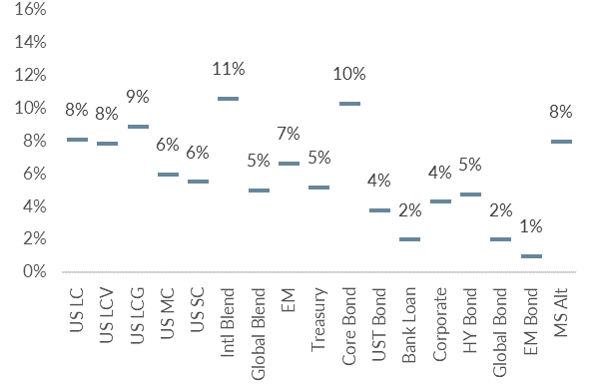
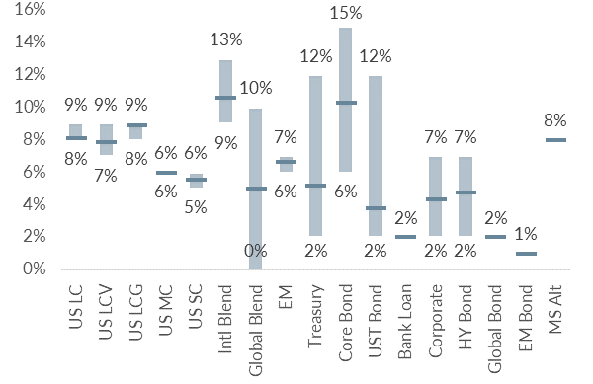
Building Investment Models
We skillfully blend various investment strategies into a unified, cohesive design that aligns with your clients' needs.
Diversified Model
Model with added Tactical Strategies
Coincident Economic Indicators
Duration Management
Asset Class Relative Strength
ADVISOR USE ONLY

Slide 30
Personalized models for the fiduciary advisor
Over 30 Strategies
Modelist Resources
Fully Transparent
Frequent Content
Competence
Advisor
Model Portfolios
Fully Customized
Credibility
Narrative Continuity
Communication
Your
Brand
Brand Optics
Compliant
Process Control
Fund Preferences
ADVISOR USE ONLY

Slide 31

Questions &
And answers
ADVISOR USE ONLY
31

Slide 32

Learn More
Unlock Opportunities
Modelist empowers you with tailored investment models, evidence-based strategies, and comprehensive support.
Elevate Your Business with Modelist
Explore Further
Dive deeper into the advantages that Modelist offers and discover how it can transform your advisory approach.
Take Action
612-887-9897
Elevate your advisory business by partnering with Modelist. Join us today and experience the difference for yourself.
hello@modelist.me
www.modelist.me
ADVISOR USE ONLY

Slide 33
Disclosures
Modelist Inc. is a registered investment adviser. Information presented is for educational purposes only and does not intend to make an offer or solicitation for the sale or purchase of any specific securities, investments, or investment strategies. Investments involve risk and, unless otherwise stated, are not guaranteed. Be sure to first consult with a qualified financial adviser and/or tax professional before implementing any strategy discussed herein. Past performance is not indicative of future performance.

